Slide 1
PRESENTATION ON FEDERATED LEARNING USING NASA TURBOFAN DATASET
BY
KANAD SEN (22M1674)
SUSHRUT JAYANT MESHRAM (22M1683)
GUIDED BY: PROF. MAKARAND S. KULKARNI
DEPARTMENT OF MECHANICAL ENGINEERING , IIT BOMBAY
kanadsen/ME_773_PROJECT: FEDERATED LEARNING USING FLOWER ON NASA TURBOFAN DATASET (github.com)

Slide 2
Objectives of the project
The main objective of the project
Perform Exploratory Data Analysis.
Use PCA to obtain reduced dimensions
Train the dataset
Apply a Deep Learning Model (CNN1D) to predict RUL of an engine.
Federated Learning using flower.

Slide 3
SMILES data information & architecture
Conversion of SMILES to Graph data and its representation
Traditional methods in molecular property prediction.
Advantages of Graphical Representation.
Data collection
Data Processing
Conclusion
Reference

Slide 4
Background of the problem
Where did you find it ?
While going through the list of projects floated, we got some idea about the different types of topics that we can search on.
We want to do project related to graphical neural network as it is one of the hot topics right now.
We searched a lot of papers on Nature, Google scholar, Science direct, ACS but getting the dataset has been the major problem.
Finally we got the dataset of the 5276 molecules in SMILES format which also contains the boiling point of the molecules.
Why is it important ?
The application of machine learning models to predicting the properties of materials usually becomes necessary in two scenarios. Molecular property prediction is of crucial importance in many disciplines such as drug discovery, molecular biology, or material and process design.
First, prediction from physics-based models is too slow due to the large size or high complexity of the material system.
Second, developing an accurate physics-based predictive model is too challenging due to the insufficient understanding of the underlying physical processes, e.g., for materials with high compositional/structural complexity or under complex/extreme conditions

Slide 5
How is it solved currently / traditionally ? What are the short comings in the current solution ? Have you been able to find data ? When explaining above, use as much graphics as possible. You can use upto 5 slides for this.
Recently, graph neural networks (GNNs) have revolutionized the field of chemical property prediction and achieved state-of-the-art results on benchmark data sets. Compared with the traditional descriptor- and fingerprint-based QSAR models, GNNs can learn task related representations, which completely gets rid of the rules defined by experts.

Slide 6
Graph neural networks (GNNs) have emerged as a powerful tool for learning representations of molecular graphs and predicting molecular properties. In recent years, GNNs have been increasingly used in the field of computational chemistry to predict molecular structure-property relationships. One important application of GNNs in this domain is the prediction of molecular properties from Simplified Molecular Input Line Entry System (SMILES) datasets.
SMILES is a widely used textual representation of molecular structures, which encodes the structure of a molecule as a string of characters. SMILES datasets have been extensively used in the development of machine learning models for molecular property prediction. GNNs, in particular, have shown remarkable performance in predicting molecular properties from SMILES datasets.
The importance and usefulness of GNNs for predicting molecular structure-property relationships lie in their ability to capture the structural features of molecules and to learn representations of molecules that are invariant to rotation, translation, and other transformations. This is particularly important in drug discovery and material science, where the properties of a molecule depend on its three-dimensional structure and the spatial arrangement of its constituent atoms.
In summary, GNNs are a promising tool for predicting molecular structure-property relationships from SMILES datasets. They can provide insights into the complex interactions between molecular structures and properties and have the potential to accelerate the discovery of new drugs and materials.

Slide 7
GNNs can handle large and complex molecules that QSAR models may struggle with, as they can capture the local and global structure of the molecule and use it to make predictions.
QSAR models use molecular descriptors (e.g., molecular weight, number of bonds, electronegativity, etc.) to represent the structure of a molecule and relate it to its properties (e.g., toxicity, solubility, bioactivity, etc.) using statistical and machine learning methods
GNNs are used in place of QSAR for SMILES dataset of molecules property when the structure of the molecules is complex and needs to be analyzed as a graph. GNNs can extract more useful information from the molecular graph than traditional QSAR descriptors, which may not be able to capture the complex interactions between atoms and their neighbors.

Slide 8
One of the key advantages of GNNs is their ability to handle graphs with varying sizes and structures. This is particularly important for predicting molecular properties, as molecules can have different numbers of atoms and bonds, and their structures can vary significantly. GNNs can also learn from the local environment of each atom and incorporate global information about the entire molecule.
The use of GNNs for predicting molecular properties has already led to significant advances in drug discovery and materials science. By accurately predicting molecular properties, GNNs can help identify promising drug candidates and materials with desirable properties, accelerating the development of new drugs and materials.

Slide 9
requirements
import tensorflow as tf
import numpy as np
import pandas as pd
import sklearn
import os
import seaborn as sns
from sklearn.model_selection import train_test_split
import sys
from sklearn.preprocessing import StandardScaler
from sklearn.preprocessing import MinMaxScaler
from sklearn.metrics import mean_squared_error
import matplotlib.pyplot as plt
import random
import json
import papermill as pm
import torch
from tqdm import tqdm #tqdm is used for progress bar
from io import StringIO
import argparse
import requests
from sklearn.metrics import confusion_matrix, accuracy_score #Scikit Learn
Can be found in packages_imp.py

Slide 10
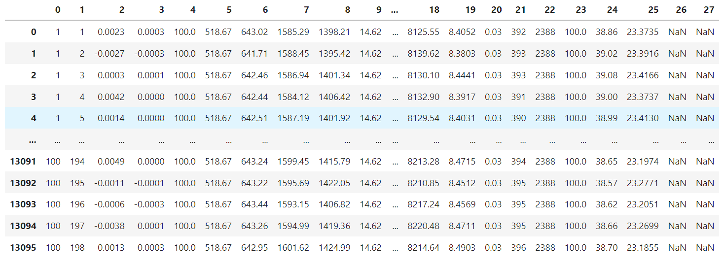
Initial dataset
https://ti.arc.nasa.gov/tech/dash/groups/pcoe/prognostic-data-repository
Columns to be dropped
3 Operational settings columns
Cycle time column
Engine ID column with Engine ID from 1 to 100
Sensor columns

Slide 11
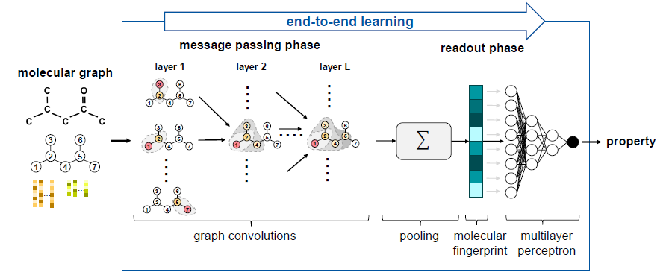
Graph neural networks for molecular property prediction

Slide 12
GNNs are a deep learning method capable of learning properties from graph representations, thereby enabling end-to-end learning from molecular graphs to properties.
GNNs learn graph properties by aggregating the characteristics of local graph regions into an overall graph representation.
For molecular property prediction, typically, GNNs in the form of message passing neural networks (MPNNs) are used and are structured into two phases, the message passing phase and the readout phase.
In the message passing phase, the molecular structure is learned by employing so-called graph convolutions. Graph convolutions enable each node within the graph to receive information about its neighboring nodes and edges.
In the subsequent readout phase, the learned structure information is aggregated into a molecular fingerprint vector which is then mapped to the molecular property of interest by means of, e.g., a multilayer perceptron.

Slide 13
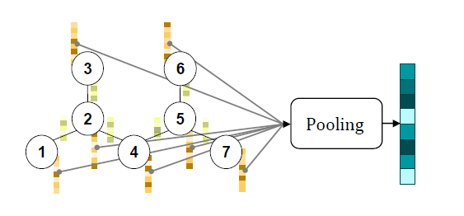

Slide 14
Atom features for initial node feature vector**
Feature | Description/Exemplary values
Atom type | Type of atom (C, N, O, P, S, F, Cl, Br, I, Si)
Is in ring | Whether the atom is a part of ring
Is aromatic | Whether the atom is a part of an aromatic system
Hybridization | sp, sp2,sp3, sp3d2
Charge | Formal charge of the atom
Bonds | Number of bonds the atom is involved in
Hs | Number of bonded hydrogen atoms
Table1
Bond features for initial edge feature vector**
Feature | Description/Exemplary values
Bond type | Single, double, triple or aromatic
Conjugated | Whether the bond is conjugated
Is in ring | Whether the bond is a part of a ring
Table2
# Stereoisomer's ( cis/trans) form of the molecules have not been included in the bond feature due to lack of information in our SMILES dataset.
** All features are implemented as one-hot encoders.

Slide 15
SMILES Specifications
In SMILES, hydrogen are typically implicitly implied and atoms are represented by their atomic symbol enclosed in brackets unless they are elements of the “organic subset” (B, C, N, O, P, S, F, Cl, Br, and I), which do not require brackets unless they are charged. So gold would be [Au] but chlorine would be Cl.
If hydrogen are explicitly implied brackets are used.
A formal charge is represented by one of the symbols + or -.
Single and aromatic bonds may be, and usually are, omitted.
Branches are specified by enclosures in parentheses and can be nested or stacked.
Rings are represented by breaking one single or aromatic bond in each ring, and designating this ring-closure point with a digit
immediately following the atoms connected through
the broken bond.
Function | Symbol
Single bond | -
Double bond | =
Triple bond | #
Aromatic bond | :
Positive charge | [C+]
Negative charge | [C-]
Aromatic carbon | c (lower case c)

Slide 16
Initial SMILES Dataset
S.No. | SMILES | Tb | Group1 | Group2 | Group3 | Group4 | ….. | Group423 | Group424
1 | CCC(O)CCC(F)(F)F | 413.8 | 1 | 3 | 1 | 0 | ….. | 0 | 0
2 | CCC(CC)ON(=O)=O | 413.15 | 2 | 2 | 1 | 0 | ….. | 0 | 0
3 | Clc1ccc(Cl)c(c1)C(=O)O | 574.15 | 0 | 0 | 0 | 0 | ….. | 0 | 0
4 | NC(C)Cc1ccccc1 | 476.15 | 1 | 0 | 0 | 0 | ….. | 0 | 0
5 | COc1ccc(cc1)NC(=O)C | 608.15 | 2 | 0 | 0 | 0 | ….. | 0 | 0
….. | ….. | ….. | ….. | ….. | ….. | ….. | ….. | ….. | …..
5272 | BrC(F)(F)Oc1ccc(cc1)C(C)(C)COCc2cccc(Oc3ccccc3)c2 | 564.15 | 2 | 0 | 0 | 0 | ….. | 0 | 0
5273 | OCC(C)CC(F)(F)F | 405.65 | 1 | 2 | 1 | 0 | ….. | 0 | 0
5274 | Clc1ccc(cc1)CC2CCC(C)(C)C2(O)CN3C=NC=N3 | 558.15 | 2 | 1 | 0 | 0 | ….. | 0 | 0
5275 | CCOC(=O)C(Cl)Cc1cc(c(F)cc1Cl)N2N=C(C)N(C(F)F)C2=O | 625.65 | 2 | 1 | 0 | 0 | ….. | 0 | 0
5276 | CSC(=O)c1cccc2N=NSc12 | 540.15 | 0 | 0 | 0 | 0 | ….. | 0 | 0

Slide 17
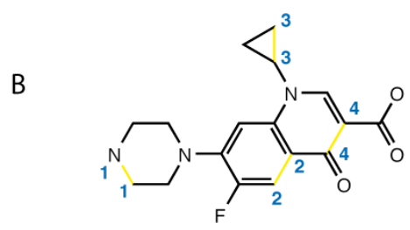
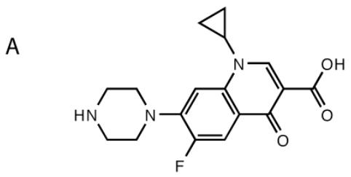
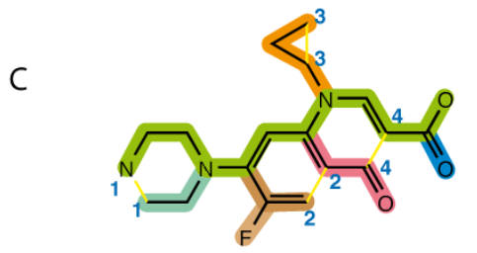
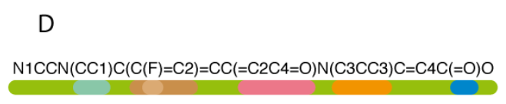
SMILES generation algorithm for ”Ciprofloxacin”: break cycles, then write as branches off a main backbone

Slide 18
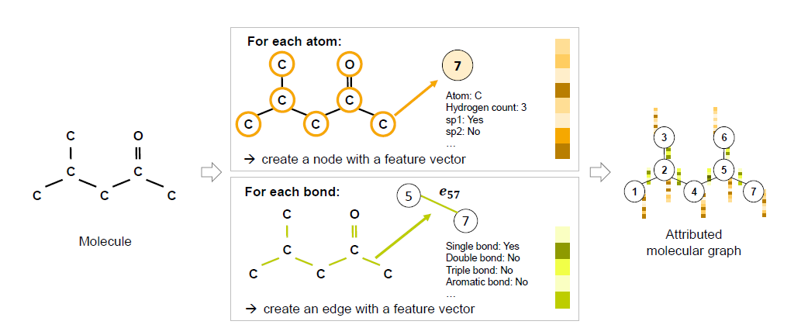
Generation of an attributed molecular graph, illustrative example for 4-methyl-2-pentanone

Slide 19
Molecular Graphs:
Any molecule can be represented as a molecular graph where nodes w, v ∈ V correspond to atoms.
Edges e_{vw} ∈ E correspond to bonds between two atoms. Furthermore, a feature vector is assigned to each node and each edge that includes information about atom types, e.g., C atom, and bond types, e.g., double bond.
The node feature vectors f ^{V}(v) can contain additional atom information such as orbital hybridization. To reduce the size of molecular graphs, hydrogen atoms can be implicitly included in the feature vectors of nodes of heavy atoms by using a hydrogen count, resulting in an H-depleted molecular graph.
Similarly, bond feature vectors f ^{E}(e_{vw}) can provide additional information, e.g., on ring structures. GNNs operate on graph structures, i.e., they take the molecular graph and its feature vectors as inputs.

Slide 20
Dataset Preprocessing
Normal boiling point data set contains 5,276 boiling points for 5,089 molecules of various classes, i.e., pure hydrocarbons, hydrocarbons with additional atoms such as oxygen, nitrogen, or fluorine, as well as multi-functional molecules.
We will randomly select 10% of the data set for testing, i.e., 509 molecules are set aside. The test set is kept unchanged in the following. The remaining 4,749 data points will be split randomly into 90% training set and 10% validation set.
We will convert the molecules provided as SMILES strings to attributed molecular graphs with the atom and bond features provided in Table 1 and Table 2, respectively, with the help of RDKit.
We extend the atom features stated in Table 1 to the atom types occurring in the data set (C, O, N, F, S, Cl, P, I, Br, Si) and exclude atom features that do not occur or do not vary, i.e., sp3d and atom charge, resulting in 20 atom features and 6 bond features in total.
We standardize the boiling point values to a Gaussian with a zero mean and standard deviation of one (Z-score normalization) for training purposes.

Slide 21
Background
While going through the list of projects floated, we got some idea about the different types of topics that we can search on.
We want to do project related to graphical neural network as it is one of the hot topics right now.
We searched a lot of papers on Nature, Google scholar, Science direct, ACS but getting the dataset has been the major problem.
Finally we got the dataset of the 5276 molecules in SMILES format which also contains the boiling point of the molecules.
This problem has a good mixture of machine learning(regression analysis) and deep learning(neural network).
SMILES is a specification in the form of a line notation for describing the structure of chemical species using short ASCII strings.
GNNs utilize a graph representation of molecules, where atoms correspond to nodes and bonds to edges containing information about the molecular structure.

Slide 22
The Simplified Molecular Input Line Entry System (SMILES) is a way to represent the 2D structure of a molecule as a text string. SMILES notation is widely used in cheminformatics and computational chemistry to encode and exchange information about molecular structures.
There are several reasons why the SMILES dataset is important for molecules:
Compact and unambiguous representation: SMILES notation provides a compact and unambiguous way to represent the 2D structure of a molecule as a text string, which can be easily shared, stored and processed.
Facilitates data analysis: SMILES notation allows large numbers of molecules to be compared and analyzed in a standardized way. This facilitates the identification of patterns and trends in large datasets of molecular structures, which can help in the discovery of new drugs and materials.
Enables virtual screening: SMILES notation allows virtual screening of large molecular databases for drug discovery. This is the process of using computational methods to search for molecules that have desirable properties for drug development.
Important for machine learning: SMILES notation is a critical input for machine learning models used for molecular property prediction, such as predicting the solubility, toxicity or biological activity of a compound.
Overall, the SMILES dataset is a valuable resource for the study of molecular structures, drug discovery and development, and computational chemistry.

Slide 23
GCN, or Graph Convolutional Networks, are a type of neural network that operate on graph data structures. Here are some advantages and disadvantages of using GCNs:
Advantages:
Handle non-Euclidean data: GCNs can handle non-Euclidean data, such as graphs, which is useful for applications where data is represented as a graph, such as social networks, citation networks, and protein interaction networks.
Utilize graph structure: GCNs can utilize the graph structure of the data to extract meaningful features and learn the relationships between nodes in the graph.
Transductive and Inductive Learning: GCNs can perform both transductive and inductive learning. Transductive learning is the process of inferring labels of nodes in a graph that have been seen during training, while inductive learning can generalize to unseen nodes in the graph.
Fewer parameters: GCNs typically have fewer parameters than traditional convolutional neural networks, making them more efficient in terms of memory and computation.
Disadvantages:
Overfitting: GCNs can overfit to the training data, especially when the graph is small or sparse.
Difficulty handling large graphs: GCNs can be computationally expensive to train and evaluate on large graphs.
Dependency on graph structure: GCNs rely on the graph structure of the data, which can be problematic if the graph is noisy, incomplete, or poorly structured.
Interpretability: GCNs can be difficult to interpret due to the complex interactions between the nodes in the graph.

Slide 24
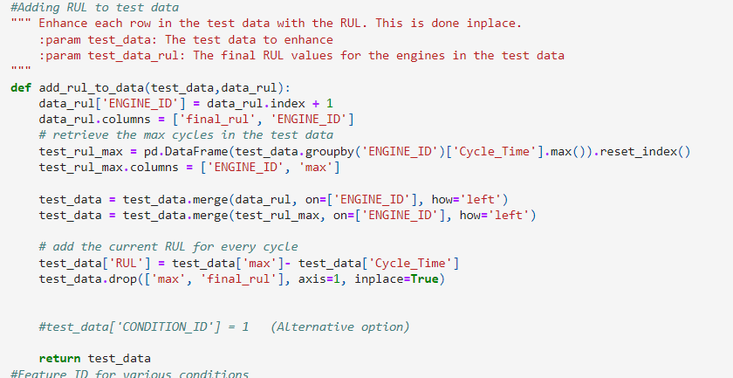

Steps to be followed
Drop 26 and 27th columns from the data set as they contain NAN values.
Add header of each columns.
Add RUL to the data using add_rul_to_data(dataset) Function:
EOL= END OF LIFE CYCLE
RUL= REMAINING USEFUL LIFE
RUL=EOL-CYCLE TIME
Save the various Train, test datasets in csv format

Slide 25
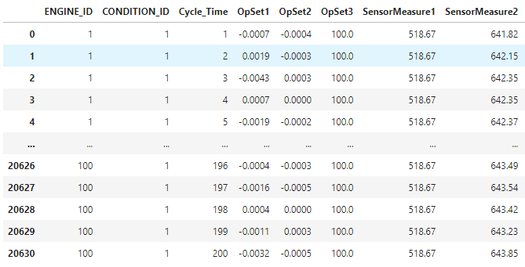
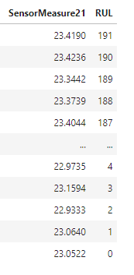
FINAL FORMATTED DATASET

Slide 26
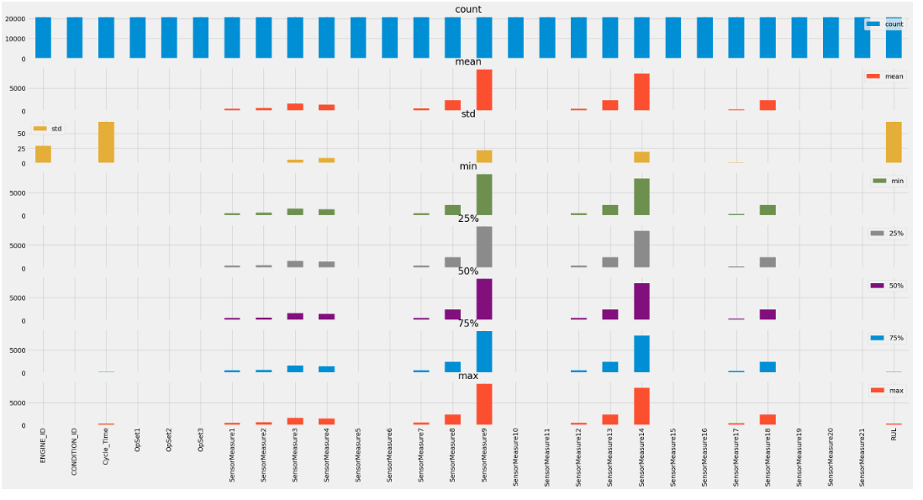
Statistics of the data set
Checking for uniqueness in the dataset column. If number of rows unique less than 2 then drop

Slide 27
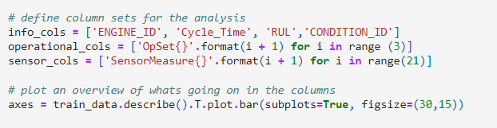
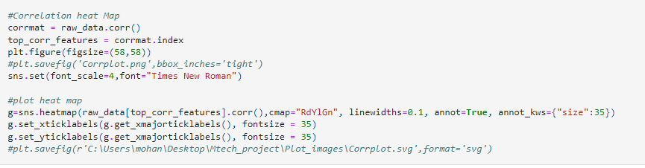
Segregation of features based on type of column data
Applying and Plotting correlation heatmap

Slide 28
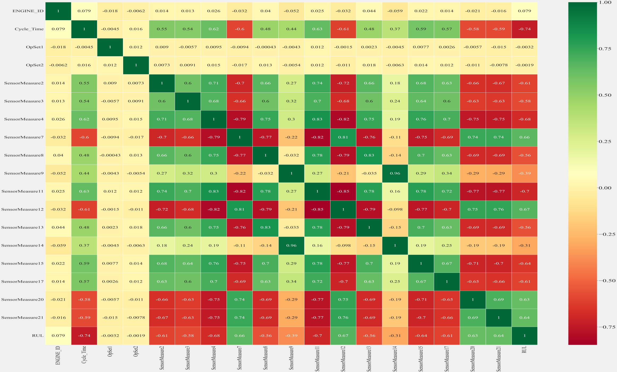
Correlation heatmap

Slide 29
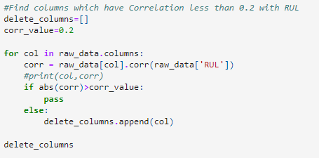
Dropping columns having correlation less than 0.2
Correlation heatmaps are a type of plot that visualize the strength of relationships between numerical variables. Correlation plots are used to understand which variables are related to each other and the strength of this relationship. A correlation plot typically contains a number of numerical variables, with each variable represented by a column. The rows represent the relationship between each pair of variables. The values in the cells indicate the strength of the relationship, with positive values indicating a positive relationship and negative values indicating a negative relationship.
In this case we are considering only those column which have an absolute correlation with RUL greater than 0.2.

Slide 30

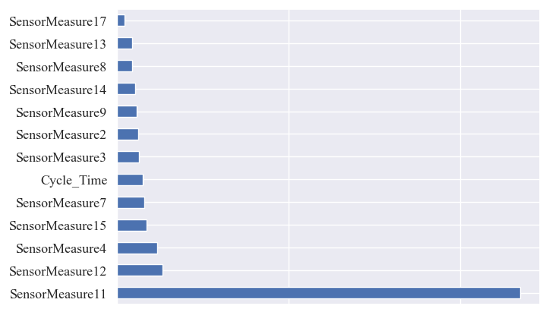
Final features after eda
Weightage of each feature based on decision tree regressor

Slide 31
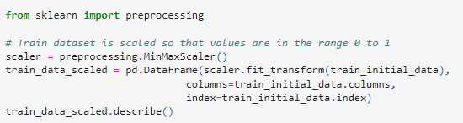
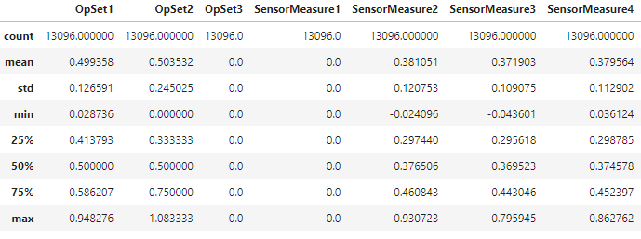
Principal Component Analysis
PCA is a statistical technique used to reduce a dimension of a dataset. The first principal component can equivalently be defined as a direction that maximizes the variance of the projected data which are nothing but the eigen vectors of the data’s covariance matrix.
Steps:
Scaling of the Train dataset so that all the statistical value ranges lie between zero to one
Result

Slide 32
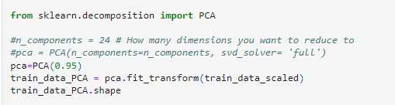
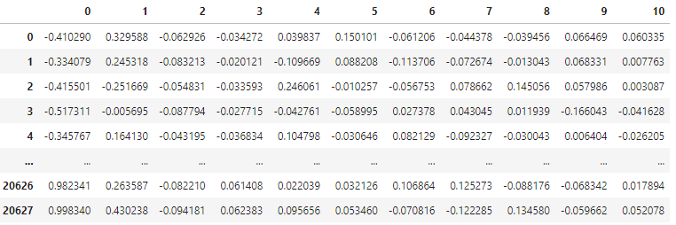
2. Applying a PCA Model while retaining 95% of information
Reduced dimensions are obtained

Slide 33
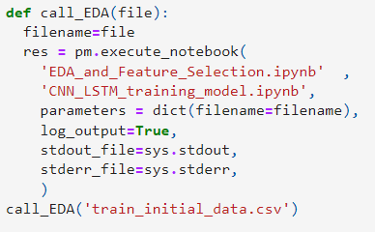
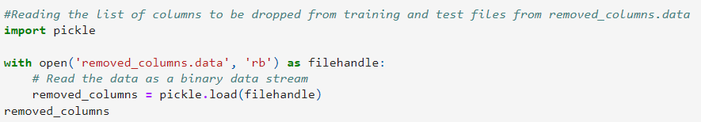
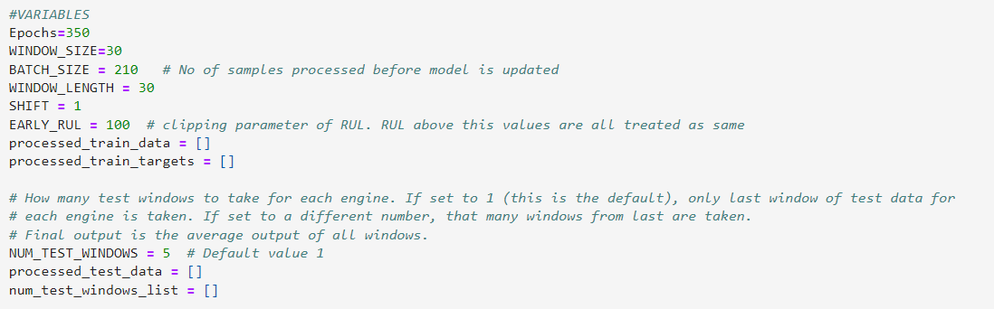
CNN File components
We are considering that for every dataset the number of columns that are relevant are different. So we have to store the columns which have to be dropped.
List of Important variables. They have been discussed in the next slide

Slide 34
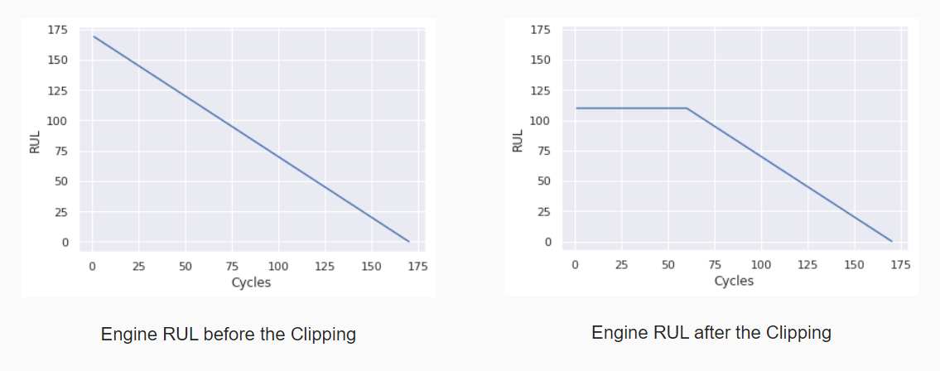
CNN File variables
RUL Clipping
Here we are Clipping the RUL to 100 here as can be seen from the EARLY_RUL variable.
This is done so as to prevent over fitting of the data which may give wrong RUL output. That is why we are treating the maximum RUL possible is 100.

Slide 35
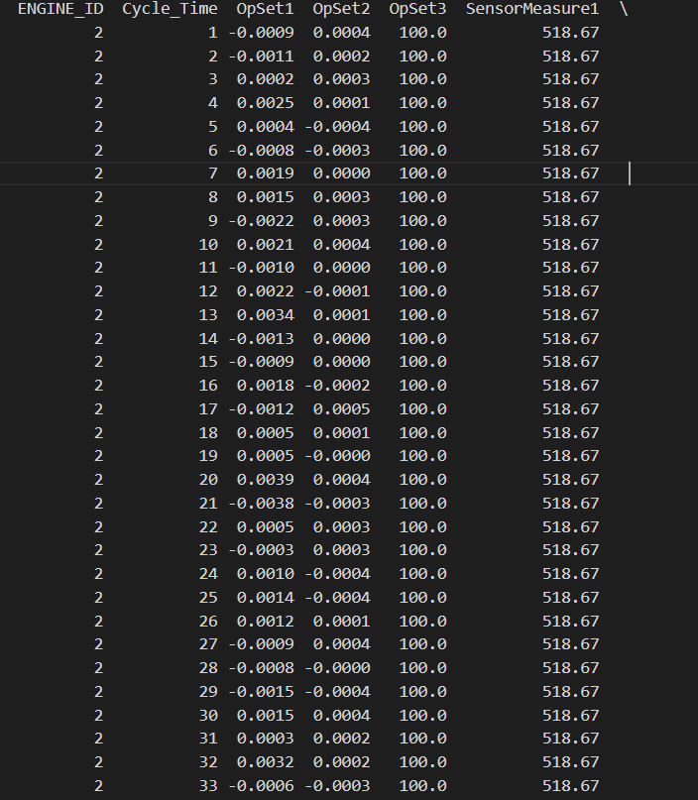
Sliding window technique
Here we have used the sliding window technique of CNN 1D model. In this case a window size of 30 has been chosen with no skipping of cycles when moving from one window to another.
Shift that window down by one cycle. Predict the result of 32nd cycle using cycles 2 to 31st and also based on the result of the 31st. Like this we continue sliding down to find the result of the final cycle.
Predict the result for 31st cycle using the values of previous 30 cycles.

Slide 36
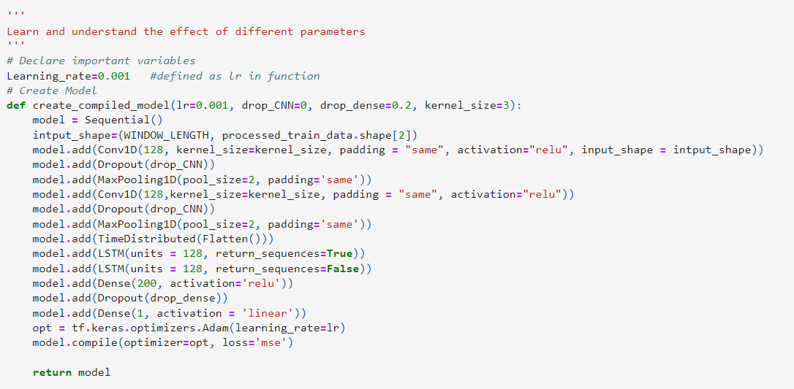
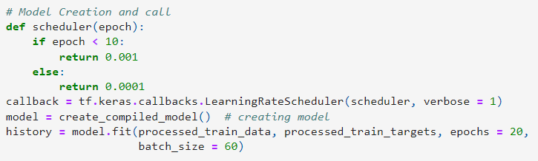
CNN model
Model definition
Model creation and call. Callback is done to get model updates at regular intervals.

Slide 37
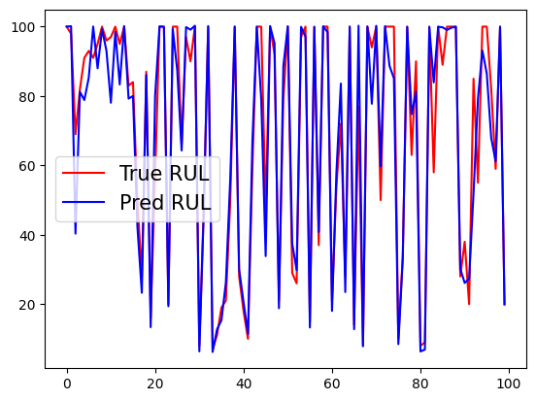
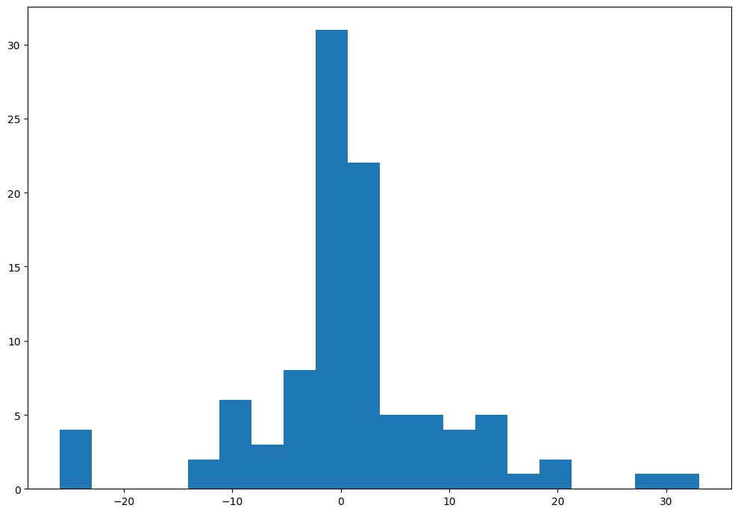
RESULTS
Histogram Plot of number of engines and magnitude of error in cycles
Plot of True RUL and predicted RUL for all Engine ID

Slide 38
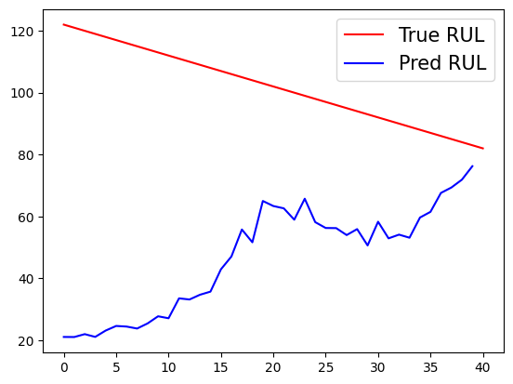
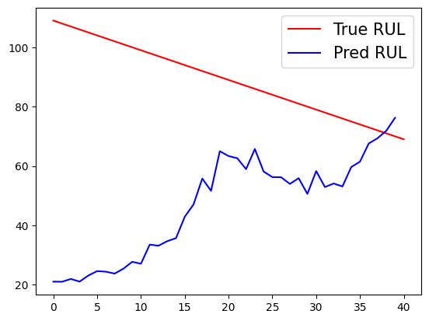
RESULTS continuation
error
error
Plot of True RUL and Pred RUL for last 40 cycles for a single engine id.
It can be seen that error is more at the start which gradually starts decreasing as we move towards the end of cycles

Slide 39
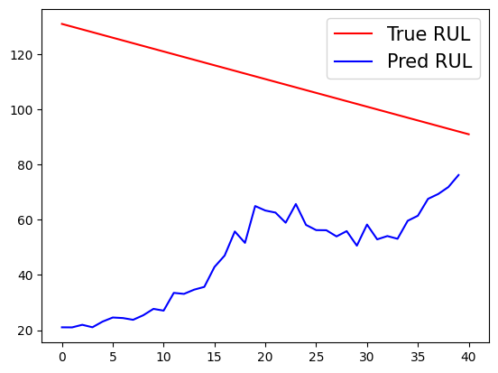
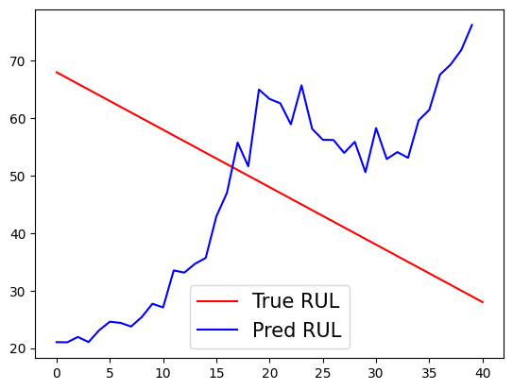
RESULTS continuation

Slide 40
RESULTS continuation
The maximum accuracy obtained from our CNN model is 94 % for the entire dataset for upto an error of 10 cycles deviation from the true RUL. This error is obtained taking into consideration the average predicted result of the last 5 cycles of an engine.
The mean squared error of the predicted results and the true RUL comes out to be 8.936.
The prediction of true RUL results appear to be converging with increased Cycle time.
The accuracy increases as the prediction moves towards the end of the
cycle time given.

Slide 41
Method to decrease error
To decrease the error as found in the previous graphs of each Engine ID we have thought of Adding weights to each Cycle time of the Engine uniformly distributed between [0,1] in increasing order of the Cycle time.
However, we have found out that adding weights based on solely focusing on the Cycle time will lead to large deviation in prediction of true RUL in this case because the maximum weight depends not on Cycle Time but also on other sensor data.
So, a well defined weight which is a function of 4 sensor data and cycle Time has to be established in order to give proper weightage to preceding results.
Another way can be is to completely redefine the neural network to accept/ incorporate the weights of preceding results into the current result

Slide 42
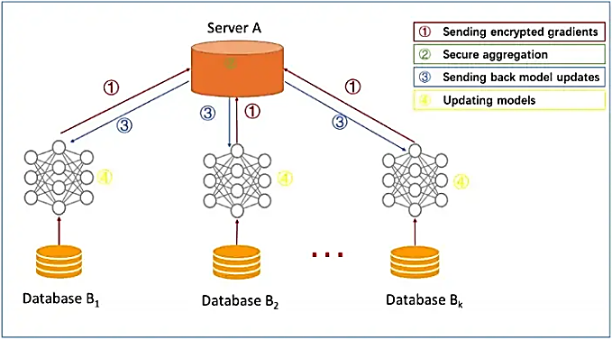
federated learning
In federated learning, the server sends the global model parameters to the client, and the client updates the local model with the parameters received from the server. It then trains the model on the local data (which changes the model parameters locally) and sends the updated/changed model parameters back to the server.

Slide 43
Federated learning using flower framework
Steps to implement the federated learning:
Start the server.py file in the command line. Local host server will be created.
fl.server.start_server(config=fl.server.ServerConfig(num_rounds=3))
Server address for hosting the model: 127.0.0.1:8080
Central server
Class containing our dataset
Class of a central server through which model is passed to the local server

Slide 44
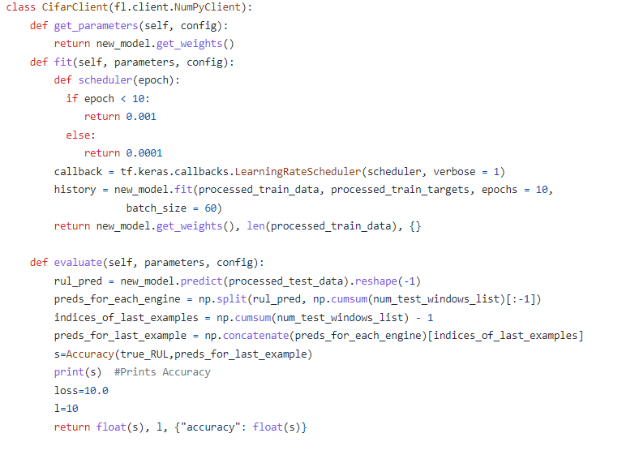
Returning updated parameters to the Fl client which is central server here
Fitting and Training the model onto our local dataset

Slide 45
CONCLUSION
After performing EDA the final features were reduced to 14 with maximum weightage to feature “Sensor measurement 11”. Hence Sensor 11 was the most important feature in prediction of RUL.
Applying PCA to the dataset and retaining the accuracy to 95%, the model features were reduced to 10 dimensions. Applying PCA, increased the speed of execution with a compromise on accuracy of the model.
Accuracy of CNN model was found to be 94%. Taking into account the given no. of cycles in our dataset and for 90% of the engine id’s the error was within 10 cycles, it is suffice to say that if the data is large enough (1000’s cycle), extrapolating the model will yield good results and thus this model can be applied to engine with large datasets.
For Federated Learning, The accuracy for client one was 85 % and for client 2 it was found to be 90%. Thus the overall accuracy of the Federated Model observed was 93%

Slide 46
THANK YOU

